Slide 1
PORTOFOLIO
Maintenance Data & Monitoring System

Slide 2
DAILY UNIT RECORD

Slide 3
Maintenance Master Data

Slide 4
Summary Issue Weekly

Slide 5
Summary Issue Daily

Slide 6
Unit Down Time

Slide 7
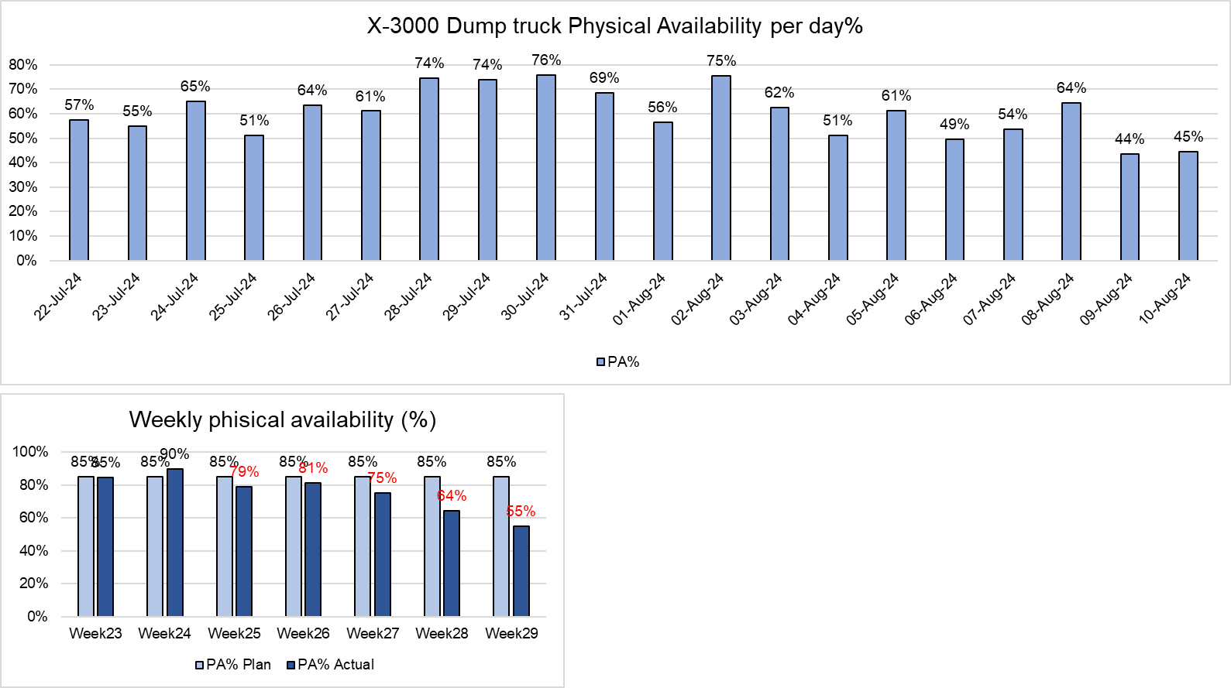
Unit Physical Availaility %

Slide 8
Summary HM

Slide 9
Utilisasion

Slide 10
Monitoring Preventive Maintenance Service

Slide 11
Service History
SERVICE HISTORY
 | PILIH SLAH SATU | ISI MANUAL |  |  |  |  | ISI MANUAL
NO | UNIT ID | HM | PLAN HM | ACTUAL SERVICE DATE | SHIFTING PROGRES | DEVIASI | FILTER REPLACEMENT
 |  |  |  |  |  |  | ENG | FUEL | WS | FUEL WS | AC | AIR | HYD
Kolom1 | Kolom2 | Kolom6 | Kolom7 | Kolom8 | Kolom14 | Kolom15 | Kolom16 | Kolom17 | Kolom18 | Kolom182 | Kolom183 | Kolom20 | Kolom21
1 | MTM-C-506 | 250,3 | 250 | 09/06/2024 | DAY | 0 | √ | √ | √ | √
2 | MTM-C-510 | 274 | 250 | 09/06/2024 | DAY | 24 | √ | √ | √ | √
3 | MTM-C-514 | 279,1 | 250 | 10/06/2024 | NIGHT | 29 | √ | √ | √ | √
4 | MTM-C-503 | 223,4 | 250 | 11/06/2024 | DAY | -27 | √ | √ | √ | √
5 | MTM-C-501 | 274 | 250 | 11/06/2024 | DAY | 24 | √ | √ | √ | √
6 | MTM-C-505 | 331,8 | 250 | 13/06/2024 | NIGHT | 82 | √ | √ | √ | √
7 | MTM-C-511 | 337,9 | 250 | 13/06/2024 | DAY | 88 | √ | √ | √ | √
8 | MTM-C-512 | 329 | 250 | 13/06/2024 | DAY | 79 | √ | √ | √ | √
9 | MTM-C-508 | 340 | 250 | 14/06/2024 | DAY | 90 | √ | √ | √ | √
10 | MTM-C-515 | 353,1 | 250 | 15/06/2024 | DAY | 103 | √ | √ | √ | √
11 | MTM-C-509 | 311,9 | 250 | 17/06/2024 | DAY | 62 | √ | √ | √ | √
12 | MTM-C-513 | 260,3 | 250 | 17/06/2024 | NIGHT | 10 | √ | √ | √ | √
13 | MTM-C-504 | 294,4 | 250 | 12/06/2024 | DAY | 44 | √ | √ | √ | √
14 | MTM-C-502 | 302,6 | 250 | 12/06/2024 | DAY | 53 | √ | √ | √ | √
15 | MTM-C-507 | 287 | 250 | 9-Jun-2024 | NIGHT | 37 | √ | √ | √ | √
16 | MTM-C-516 | 275,5 | 250 | 18-Jun-2024 | NIGHT | 26 | √ | √ | √ | √
17 | MTM-C-518 | 344 | 250 | 22-Jun-2024 | NIGHT | 94 | √ | √ | √ | √
18 | MTM-C-515 | 518 | 500 | 2-Jul-2024 | NIGHT | 18 | √ | √ | √ | √ | √
19 | MTM-C-514 | 520 | 500 | 3-Jul-2024 | NIGHT | 20 | √ | √ | √ | √ | √
20 | MTM-C-509 | 546 | 500 | 5-Jul-2024 | NIGHT | 46 | √ | √ | √ | √ | √
21 | MTM-DT-484 | 1350 | 1000 | 29-Jun-2024 | NIGHT | 350 | √ | √ | √ | √ | √ | √
22 | MTM-DT-483 | 1263 | 1000 | 29-Jun-2024 | NIGHT | 263 | √ | √ | √ | √ | √ | √
23 | MTM-DT-486 | 1184 | 1000 | 30-Jun-2024 | NIGHT | 184 | √ | √ | √ | √ | √ | √
24 | MTM-C-505 | 673 | 500 | 8-Jul-2024 | NIGHT | 173 | √ | √ | √ | √ | √
25 | MTM-C-515 | 518,01 | 500 | 2-Jul-24 | DAY | 18 | √ | √ | √ | √ | √
26 | MTM-C-514 | 520 | 500 | 3-Jul-24 | NIGHT | 20 | √ | √ | √ | √
28 | MTM-C-509 | 457 | 500 | 5-Jul-24 | DAY | -43 | √ | √ | √ | √
28 | MTM-C-505 | 679 | 500 | 7-Jul-24 | NIGHT | 179 | √ | √ | √ | √
31 | MTM-C-519 | 457 | 500 | 9-Jul-24 | DAY | -43 | √ | √ | √ | √
32 | MTM-C-518 | 624 | 500 | 15-Jul-2024 | DAY | 124 | √ | √ | √ | √
33 | MTM-C-502 |  |  |  |  | 0
34 | MTM-C-488 | 1831 | 2000 | 4-Sep-2024 | DAY | -169 | √ | √ | √ | √ | √ | √ | √

Slide 12
Schedule Preventive Maintenance

